Slide 1
Project 3 Natural Language Processing Scrapping Reddit
By Susan Mensah

Slide 2
Objective
Create and compare two reddits using various classifications models.

Slide 3
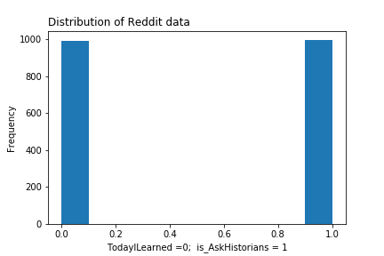
Reddits
AskHistorians: 0.5007
TodayILearned: 0.4992

Slide 4
Processes
Classifers
Count Vectorizer
TF-IDF
Models
Random Forest Classifer
Logistic Regreesion
Naïve Bayes Multinomial
Grid Search

Slide 5
Forming a baseline with a Simple model - naive Bayes
Count Vectorizer
TF-IDF
Training Score: 0.9959
Testing Score: 0.9397
Training Score: 0.9919
Testing Score: 0.9036

Slide 6
Using Grid search
Best Score: 0.9987
Params: Ridge
Logistic Regression
Training Score: 0.9993
Testing Score: 1.0

Slide 7
Outcomes Important Features
 | feature importances
words
til | 0.502101
did | 0.059702
history | 0.007826
roman | 0.007692
called | 0.006641
war | 0.006610
named | 0.005972
film | 0.005364
common | 0.004952
song | 0.004535

Slide 8
Sentiment Analysis
What_Subreddit | Compound Polarity
AskHistorians | -0.006806
todayilearned | -0.010909
Surprisingly, todayilearned has a more positive sentiment than AskHistorians. This is surprising because one would expect that there are more negative words used today than in history.
Another consideration could be that the negative sentiments in AskHistorians reddit is as a result of the wars that has occurred in history as opposed to today.

Slide 9
Conclusion
There is a Strong correlation between the reddit AsKHistorians and TodayILearnt. The most important words are 'til' and 'did' with 'til showing up 745 times and least important words are 'evian' and 'michigan' showing up just once in the corpus.

